Slide 1
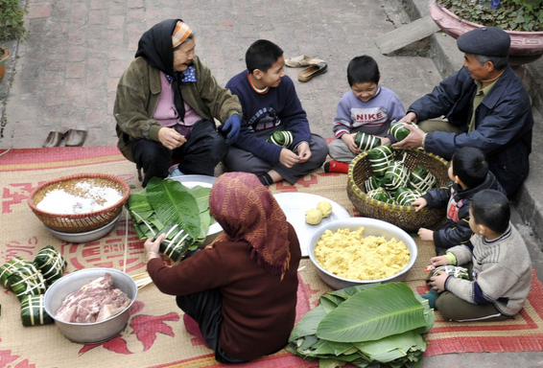
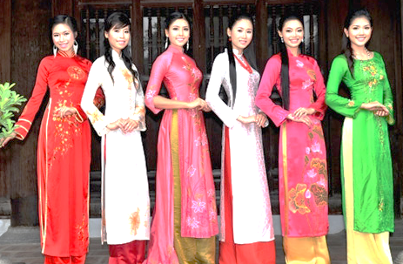
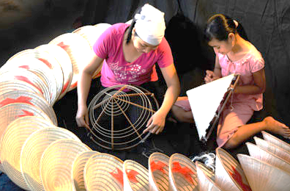
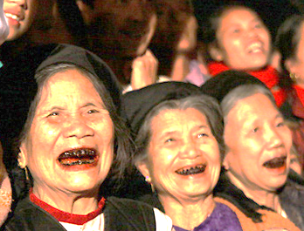
4
OUR CUSTOMS
AND TRADITIONS
Unit
Lesson 1: GETTING STARTED
A lesson on customs and traditions

Slide 2
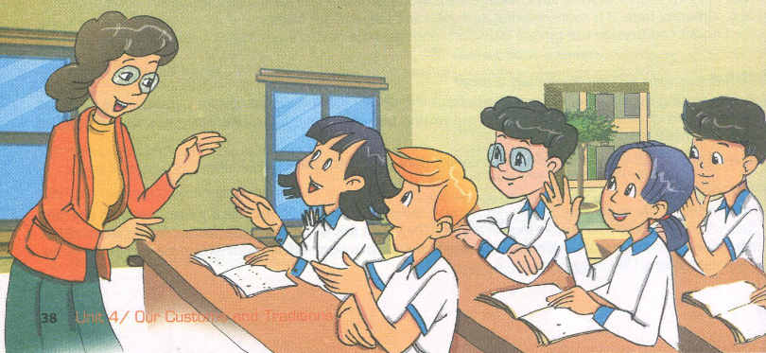
THIS UNIT IN CLUDES:
VOCABULARY
Types of customs and traditions
Expressions with “custom” and “tradition”
PRONUCIATION
Clusters: /spr/ and /str/
GRAMMAR
Should and shouldn't: review
Have to
COMMUNICATION
Describing customs and tradition
Giving advice and expressing obligation about customs and tradition

Slide 3
Vocabulary
spot on
: đúng, chính xác
1.
(a)
2.
pass down
(v)
: truyền đi
3.
sharp
(adv)
: đúng (thời gian)
4.
accept
(v)
: chấp nhận, đồng ý
5.
compliment
(n)
: lời khen ngợi
6.
table manner
(n)
: qui tắc ăn uống

Slide 4


1. Listen and read
- What can you see in the picture?
- What do you think the people in the picture are talking about?

Slide 5
1. Listen and read
a. Find the word/ phrase that means.
1. agreed
2. grandparents, parents, and children
3. totally correct
4. exactly on time
5. relating to human society
6. a polite way of eating at the dinner table
= accepted
= generations
= spot on
= sharp
= social
= table manners

Slide 6
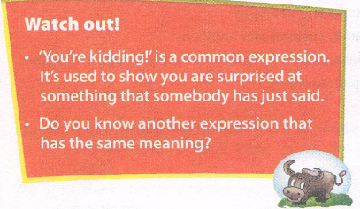
- Thành ngữ
“You’re kidding”: bạn đang đùa à.
- Một số thành ngữ tương tự:
+ “You’ve got to be kidding me!”: đừng đùa với tôi như vậy chứ?'
+ “Just kidding!” : tôi đùa thôi

Slide 7
b. Tick () true (T) or false (F).
T
F
1. Nick’s explanation of customs and traditions is correct.
2. Only families have customs and tradition.
3. In the UK there’s a tradition of having afternoon tea.
4. In the UK there is no accepted way of behaving at the
dinner table.





Slide 8
c. Answer the following questions.
1. What is Mai’s family custom?
→ It’s eating dinner at 7 p. m sharp.
2. How does Nick feel when Phong talks about one of his family
traditions?
→ He’s surprised.
3. What is the similarity between a custom and a tradition?
→ They both refer to doing something that develops over time.
4. What is the difference between them?
→ A custom is something accepted. A tradition is something special
and is passed down through the generations.
5. What should the students do for homework?
→ They should find information about a custom or tradition.

Slide 9
d. Find these sentences in the conversation and fill in the missing words.
1. We ________ be at the dinner table on time.
2. You ________ find information about a custom or tradition.
What do you thin sentences mean?
- have to: diễn tả nghĩa vụ (an oligation)
- should: diễn tả lời đề nghị hoặc lời khuyên (a suggestion or an advice)
have to
should

Slide 10
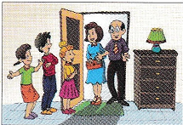
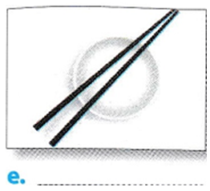
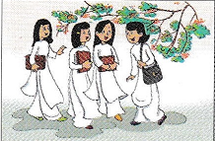
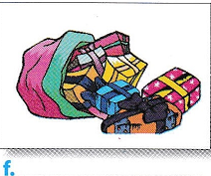
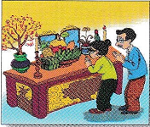
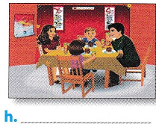
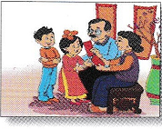
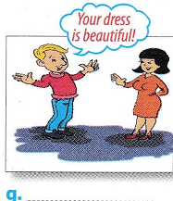
2 a. Match the pictures with the customs and traditions in the box.
1. Smiling to accept a compliment
2. Worshipping ancestors
3. Wrapping gifts in colour paper
4. Having lunch together on the
second day of Tet
5. Placing the chopsticks on top of the
rice bowl when finishing a meal
6. Children in the family standing in a
row to greet guests
7. Wearing ao dai on special occasions
8. Giving children lucky money at Tet
a. __
e. __
- 6
- 5
- 7
f. __
b. __
- 3
c. __
g. __
- 2
- 4
- 8
h. __
d. __
- 1

Slide 11
2 b. Write C (custom) or T (tradition) under each picture in a.
1
2
3
4
C
C or T
C
T
5
6
7
8
C
C
T
C or T

Slide 12
3. GAME: CUSTOMS AND TRADITION EXPERTS
1. Work in small groups
2. Take five minutes to write down as many local customs
and tradition as you can think of
3. Present your list to the other groups.
4. The group with the most ideas are the experts!

Slide 13

HOMEWORK
* Learn by heart vocabulary.
* Speak with your friends
* Prepare lesson 2: A closer look 1.

